Slide 1
Quadratic optimization with quantum computing Biweekely Presentation IV
Bálint Hantos
Supervisor: Péter Rakyta
Notes:
I’m going to be talking about today the work that we’ve been doing with Professor Rakyta this semester and the background behind it.
The reason I chose this project is that quantum computers have the potential to revolutionize computation by making certain types of classically infeasible problems solvable.
While no quantum computer is sophisticated enough to do these calculations yet. But a great progress is under way.

Slide 2
Overview
Mathematical background
Boson sampling
Variational solver
Setup
Results: Tournament scheduling, Max cut

Slide 3

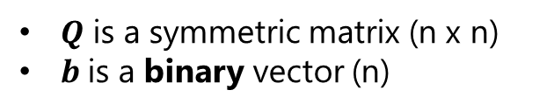
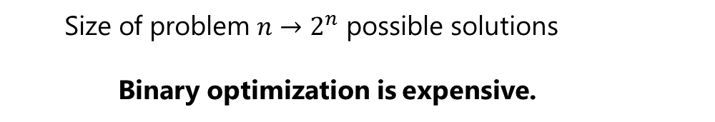
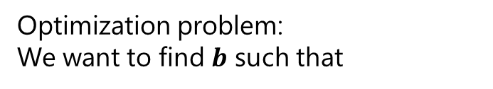

Mathematical background
$Q$ is a symmetric matrix (n x n)
$b$is a binary vector (n)
$〈 10010 | Q| 10010 〉$ = scalar
Applications:
Finance
Logistics
Number theory
Scheduling
Graph theory
Optimization problem:
We want to find $b$ such that
$$\min\left(〈 b |Q\right|b 〉)$$
Size of problem $n→2^{n}$ possible solutions
Binary optimization is expensive.

Slide 4
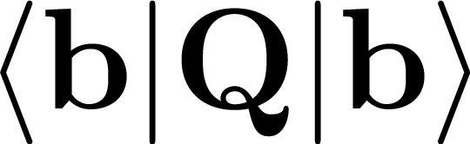
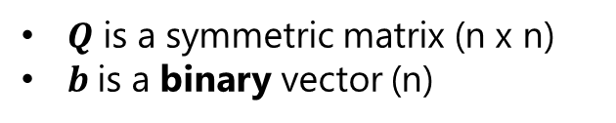
Mathematical background
- Expected value of a matrix:
$Q$ is a symmetric matrix (n x n)
$b$is a binary vector (n)
Notes:
Now we’re looking at a matrix expectation value. And this case is special because this matrix is a real valued symmetric matrix.
Additionally the vector by which the matrix is multiplied on both sides is a binary vector, meaning it only contains 0s and 1s.

Slide 5
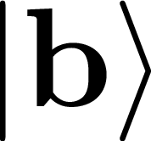
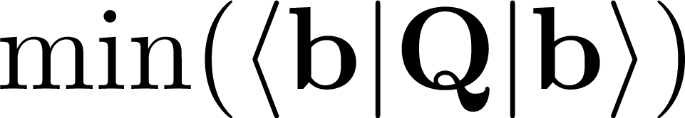
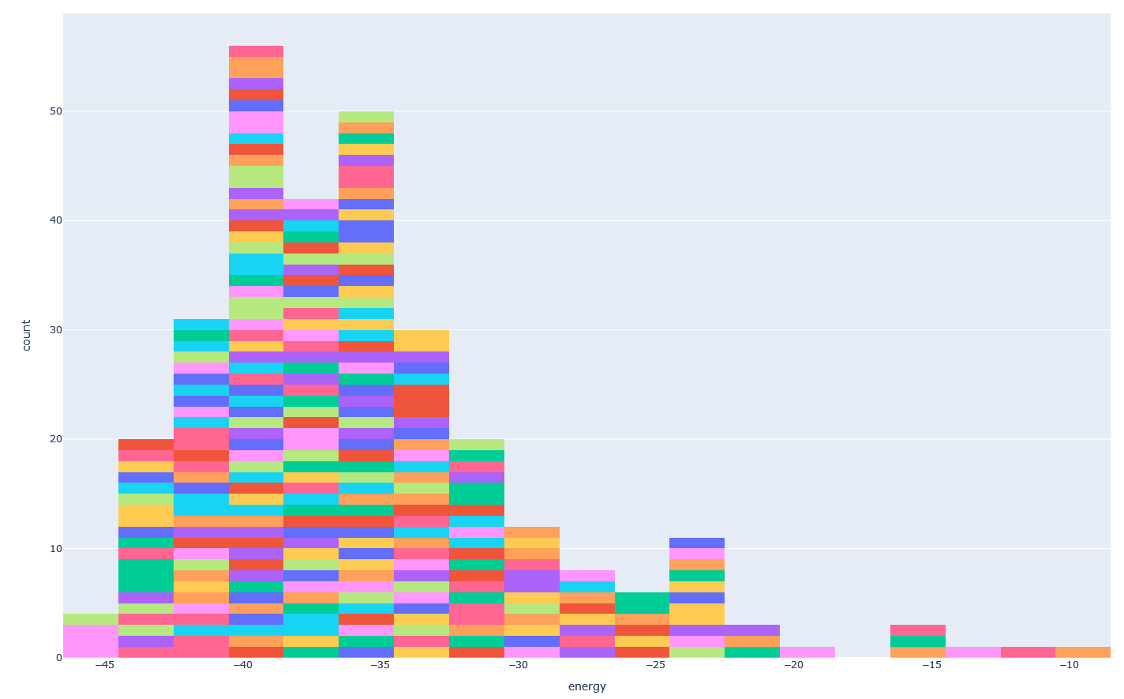

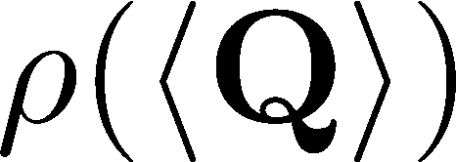

Mathematical background
- Expected value of a matrix:
$Q$ is a symmetric matrix (n x n)
$b$is a binary vector (n)
- Find such that
Explicitly (calculate all )
By sampling
Quadratic Unconstrained
Binary
Opitimization
Notes:
There is a whole distribution of these expectation values, you can see them on the right. The different colors are just different binary vectors.
With the expectation value on the x axis, and the probability density on the y.
The goal is to find the minimal expectation value of the matrix, additionally the binary vectors associated with this minimal expectation value.
This is what we call a QUBO problem.
How can we find that that value?
We can find it explicitly by calculating <Q> for all binary vectors.
Or we can find it by sampling this distribution, which way cheaper than building the whole.

Slide 6

Mathematical background
- Expected value of a matrix:
$Q$ is a symmetric matrix (n x n)
$b$is a binary vector (n)
- Find such that
Explicitly (calculate all )
By sampling
Better than random sampling?
Optimizing is hard, because is discrete
Need to find continous parameters to repr
Notes:
Then the question is, Do we know anything about the distribution?
Because we need to know if we can do anything better than random sampling?
Well, for this having to deal with continous parameters would be quite handy.
If we had continous parameters we could optimize our sampling strategy on the way, thus getting lower and lower sample expectation values and eventually reaching the minimum.
So let’s find continous parameters to represent the b vectors

Slide 7
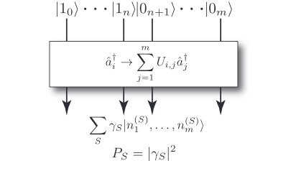

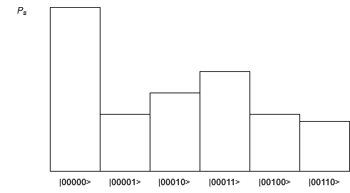

Boson sampling
Need to find continous parameters to repr
Single photon quantum states
Distribution of
Interferometer
Multiphoton quantum state
Notes:
This is when an interferometer can help our case!
An interferometer from single photons produces a multiphoton quantum state (this is similar to a b-vector).
Boson sampling is just using this interferometer over and over again to produce a distribution of these multiphoton quantum states.
Can we find anything that is continous in this setup?

Slide 8
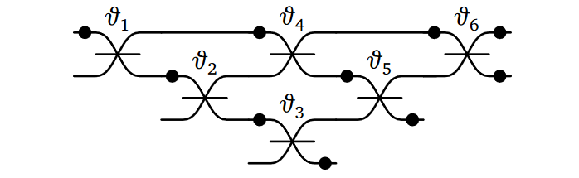
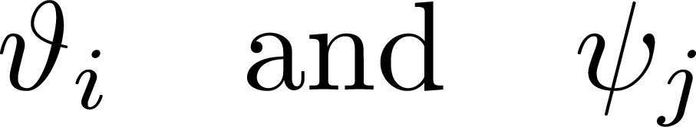
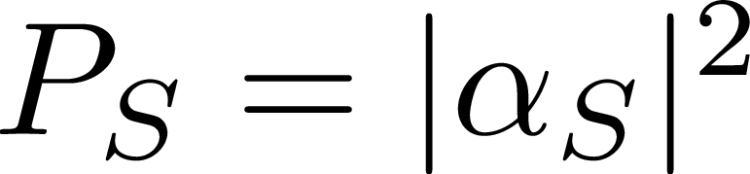
Boson sampling
Need to find continous parameters to repr
Interferometer
Single photon quantum states
Interferometer
Multiphoton quantum state
Beam splitters and phase shifters
continous
Notes:
The interferometer consists of beam splitters and phase shifters (you know like mirrors and refractive media), These mirrors can be turned by a continous angle.
And it effects the internal state of the interferometer.
Physics-wise it means, that the wave function depends on these parameters.
Then the output gets measured and we get one of the S configurations with probability alpha absolute squared.

Slide 9

Boson sampling
Need to find continous parameters to repr
Interferometer
Single photon quantum states
Distribution of
Interferometer
Multiphoton quantum state
Beam splitters and phase shifters
continous
Notes:
We do many measurements to build up a distribution for the b-vector.

Slide 10
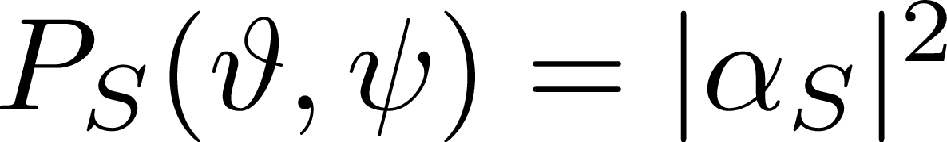
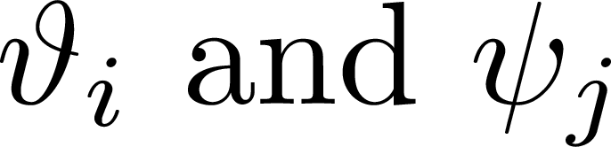
Boson sampling
Need to find continous parameters to repr
Repeat measurement many times
Distribution of quantum states:
Single photon quantum states
Interferometer
Multiphoton quantum state
Continous variables
Notes:
In order to build a rather small distribution we repeat the measurement many times.
The quantum states that are coming out depend on this interferometer internal state, so the sampled distribution changes as we are turning the mirrors.
Now, the question is: how should we turn the mirrors to sample more favorable b-vectors, to get smaller expected values?

Slide 11
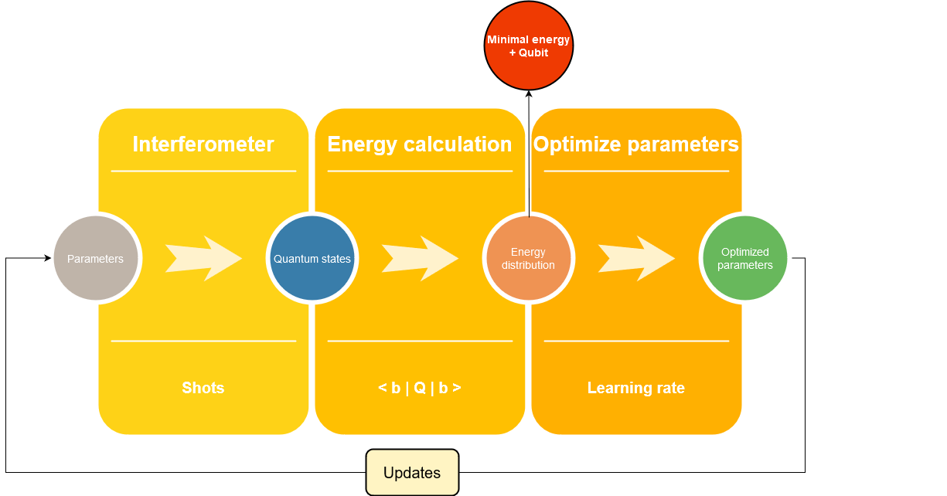
Variational solver
Better than random sampling
Notes:
We need to use the interferometer as a part of a variational solver.
This part is what I’ve been talking about before.
Parameters go in, a distribution of quantum states go out.
We calculate the energy for each quantum state, thus getting an energy distribution. In each iteration we take note of the minimal energy and the b-vector associatied with it.
And then comes the important part, where we’re taking a gradient step towards a smaller energy by optimizing the parameters.
This is why it is more efficient than random sampling.
Because of the optimized parameters we should get lower and lower energies.
Okay, so this method sounds kinda interesting, how can somebody try it out?

Slide 12

Setup
Piquasso – simulator for photonic quantum computations
Piquassoboost – for performance improvement
Personal use:
Ubuntu on Docker for a separated application environment
Simulating a Boson Sampler is computationally expensive
Budapest Quantum Computing Group server:
2x32 Core CPU
FPGA server
Notes:
If someone needs to use a boson sampler or the variational solver, they can do as we did,
As we used the piquasso library that gives us an exact simulator for photonic quantum computations.
Additionally we needed to use the Piquassoboost library which serves as a more powerful C++ backend to improve performance.
In the beginning I ran the simulations on my own computer on Ubuntu in a Docker container, to provide a separate environment for the application.
Later we needed to run bigger simulations, and as they are being expensive, we run them on the Budapest quantum computing group’s server, which has 2 powerful CPUs and the speeduf of FPGAs.

Slide 13
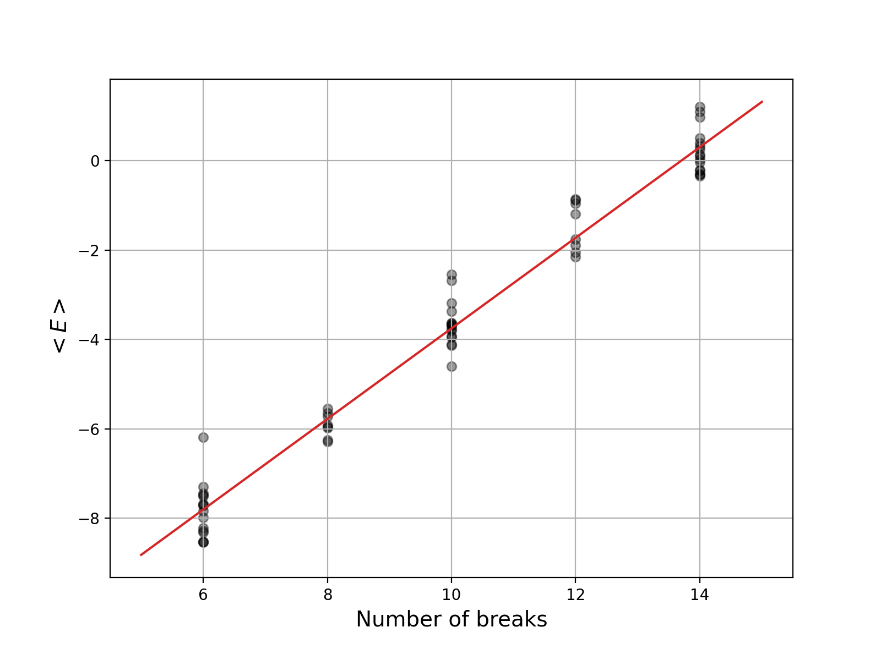
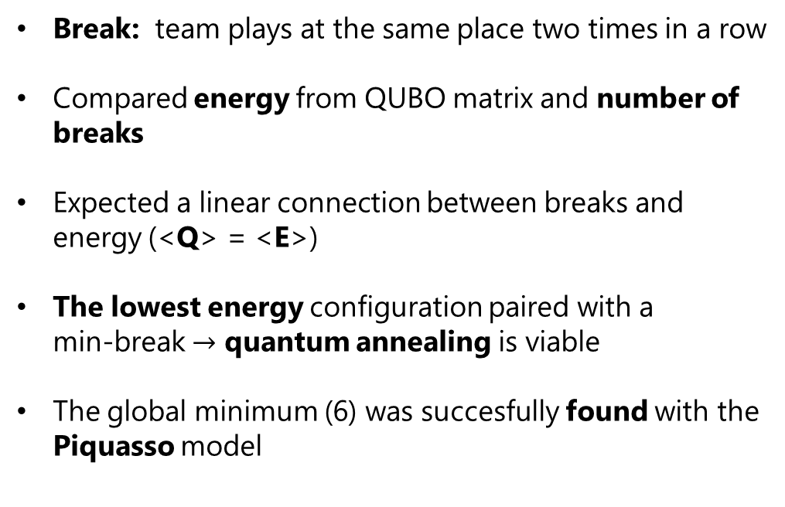
Results: break minimization
Break: team plays at the same place two times in a row
Compared energy from QUBO matrix and number of breaks
Expected a linear connection between breaks and energy (<Q> = <E>)
The lowest energy configuration paired with a min-break $→$ quantum annealing is viable
The global minimum (6) was succesfully found with the Piquasso model
Notes:
Now, turn to the results of this work, what we’ve done.
You might be able to remember when I was talking about sports tournament scheduling.
The goal was to avoid or at least minimize breaks in a tournamnets.
A break is when a team plays at the same place (away or home) two times in a row.
However, as the break minimization entailed a lot more tedious calculations than just producing the QUBO matrix, we turned to a different problem, the Max-Cut Problem.

Slide 14
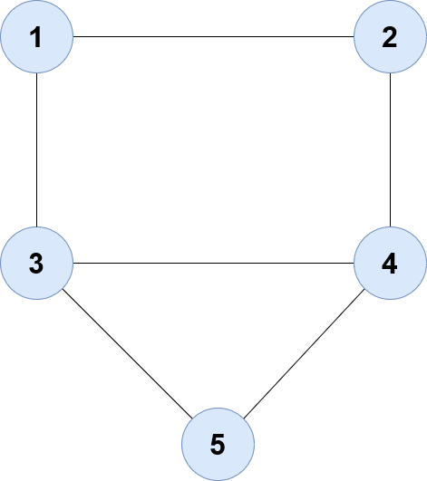
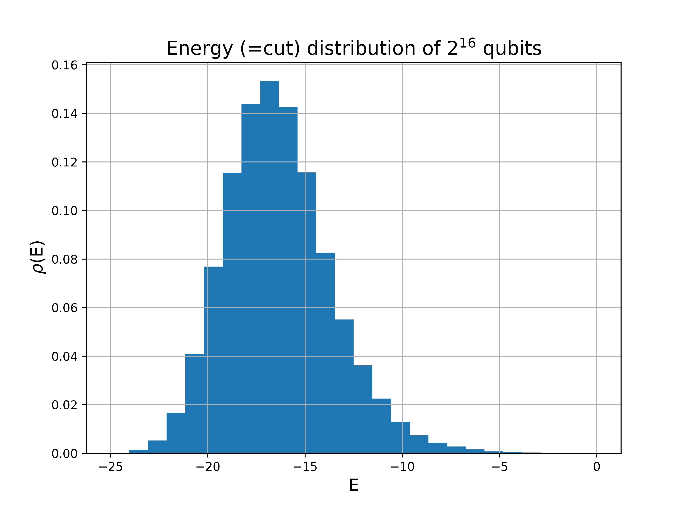
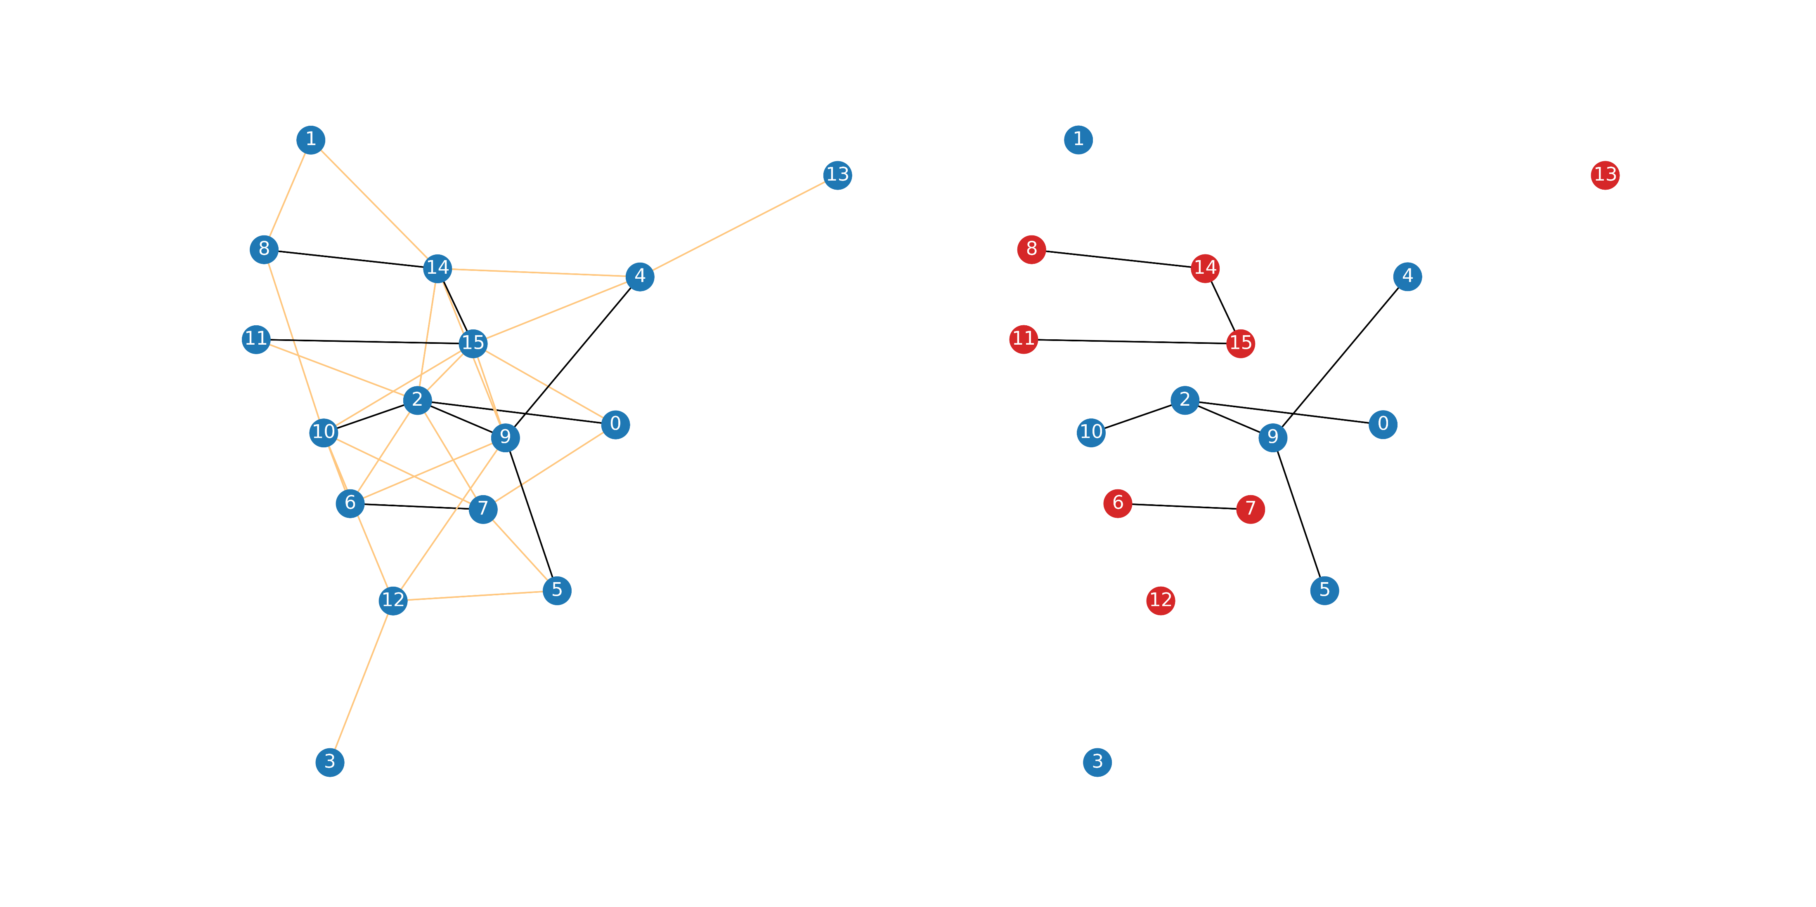



Results: Max-cut
Network without the cut
N = 16
Network with Max-cut
N = 16
Variational (best): - 24
exact: min(E) = -24
Shots: 20
Updates: 30
Notes:
The max-cut problem was about partitioning a network into two sets of nodes, while we cut the maximum amount of edges between the sets.
For this problem we created the QUBO matrix for a given graph.
This time I chose a Erdős-Rényi graph. Then run some simulations on the bosonic variational solver.
Compared it with the exact solution and found that we reached the exact optimum of the max cut.
This is what network looks like without the cut. The edges soon to be cut are with orange.
On the right you can see the same network after the max cut. The nodes are colored according to which sets they are assigned to.

Slide 15

Application: break minimization
Motivation: Ensure fairness in team sports
It is more favorable to play on home ground
Less travel
Psychological advantages
More comfortable climate
Measures for fairness:
Playing a in a neutral venue (no team plays at home)
Football: the away team’s score gets doubled
Balance the tournament: limit home/away games in a row

Slide 16
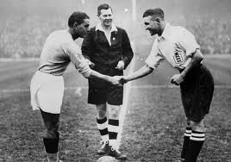
Application: break minimization
Balance the tournament: limit home/away games in a row
Break: when a team plays two consecutive games at home or away
Minimizing breaks ensures fairness
How?

Slide 17
Open questions
When will we be able to build a powerful optical quantum computer?
What physical resources and equipment will this device need?
How much do we have to improve technology to reach this?
Notes:
I’d like to begin with an open question that is:
When will we be able to build an optical quantum computer that can outperform any existing classical computer?
What physical resources and equipment (other than time and memory) will this device need?
How much do we have to improve our technology to reach this?
There was a tremendous effort made in this field. One of the results was a scheme that is quite promising, but it needs a tremendous amount of hardware:
we would need billions of linear optical elements and millions of single photon sources.
This begs the question: Is there any easier way to do this? Boson sampling answers that question.

Slide 18
Combinatorial optimization
Combinatorial optimisation problems:
Discrete variables (instead of continous)
Optimizing over discrete >> continous variables
Constraints?
Continous: add to the objective function! (eg. Lagrangian multiplier)
Discrete is hard, if there are constraints (check every case)

Slide 19
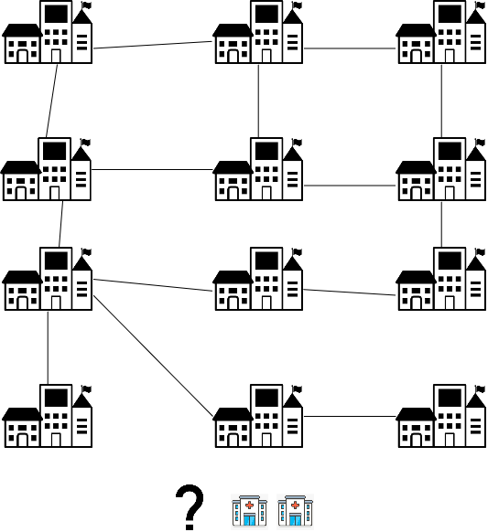

Slide 20
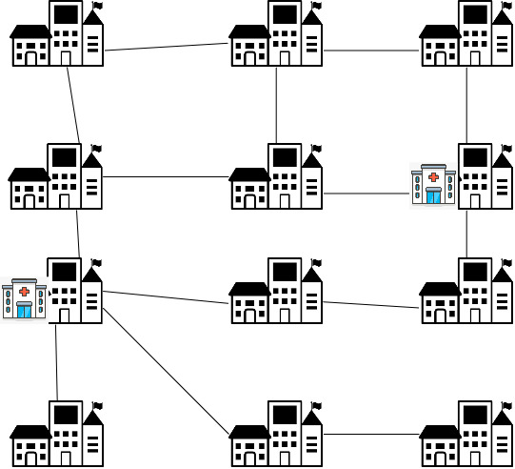

Slide 21
Max-Cut Problem
Goal: Separate the nodes into two sets while the largest amount of edges are cut
nodes
edges

Slide 22
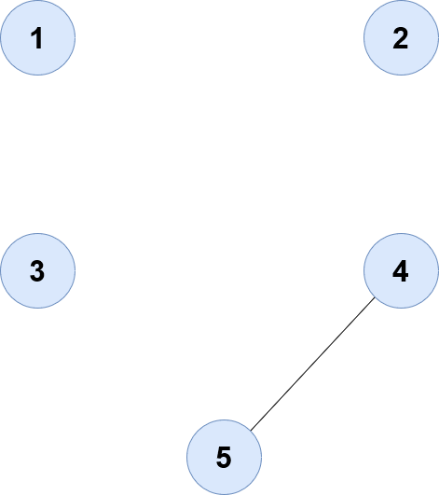
Max-Cut Problem
Goal: Separate the nodes into two sets while the largest amount of edges are cut
nodes
edges
How?

Slide 23

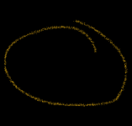




Max-Cut Problem

Slide 24
Max-Cut Problem

Slide 25
Max-Cut Problem
Goal: Separate the nodes into two sets while the largest amount of edges are cut
Notes:
The max cut is one of the most famous problems in combinatiorial optimization.
Given an undirected graph, the max cut problem aims to
We can model this problem by introducing binary variables

Slide 26
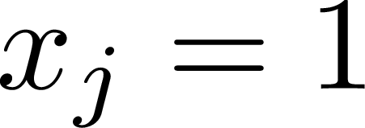

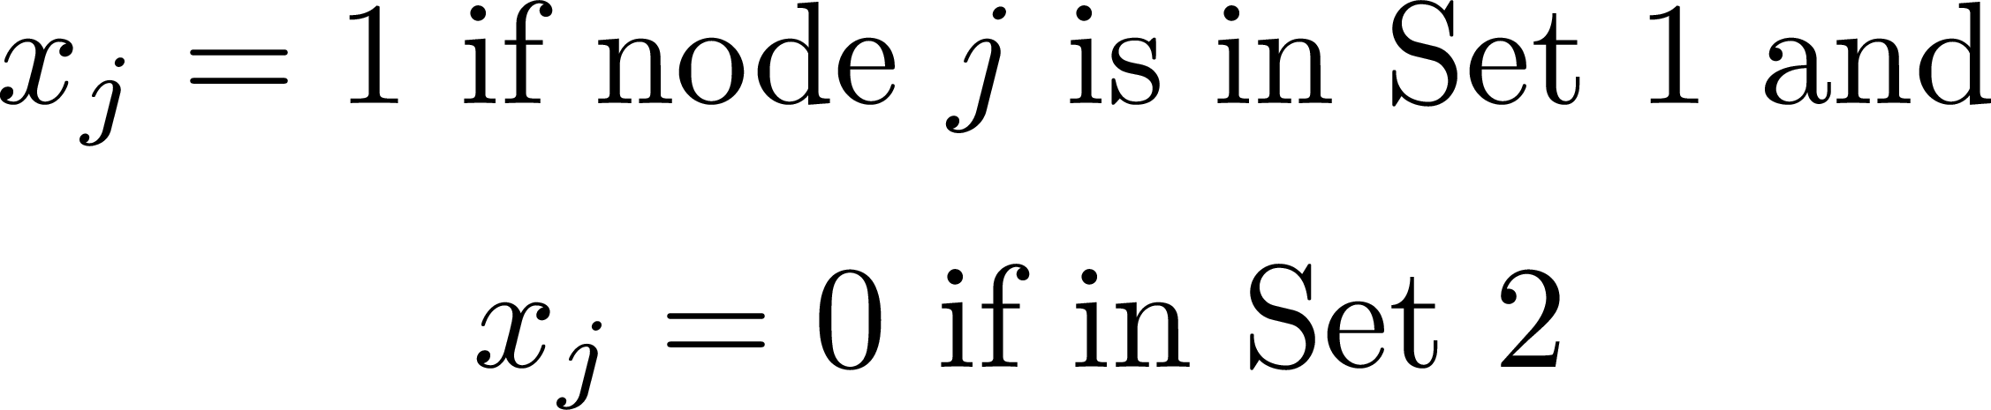
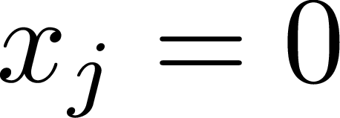
Max-Cut Problem
Goal: Separate the nodes into two sets while the largest amount of edges are cut
Binary variables

Slide 27
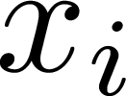
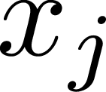
Max-Cut Problem
Goal: Separate the nodes into two sets while the largest amount of edges are cut
Binary variables
Cost function:
 |  | Cost
1 | 1 | 0
1 | 0 | +
0 | 1 | +
0 | 0 | 0
Notes:
Cost function: i and j are connected

Slide 28
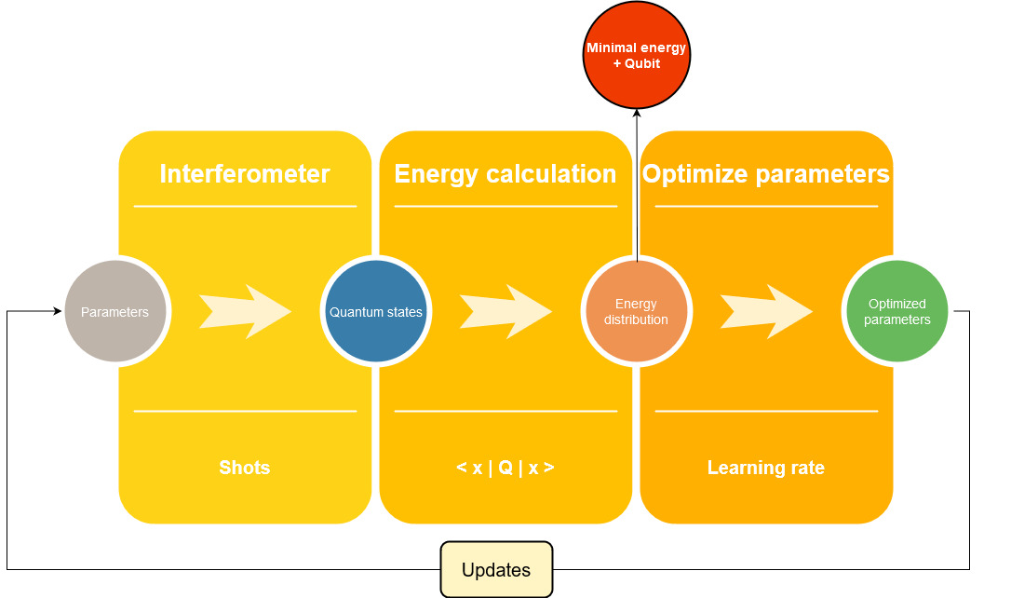
Quantum computer simulator
Piquasso – Photoninc quantum computer simulator
Boosted with FPGA server for linear algebra operations
Large speedup with splitting up the QUBO matrix
Hyperparameters
Variational bosonic solver Mini-batch gradient descent
Updates x Shots
Epochs x Batch size
Learning rate
Learning rate

Slide 29
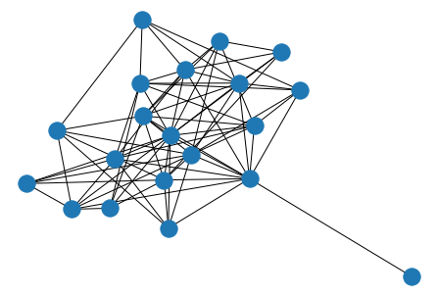
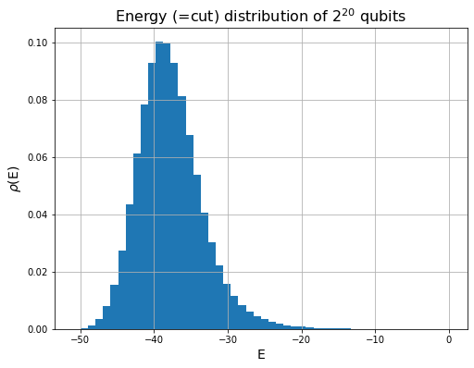
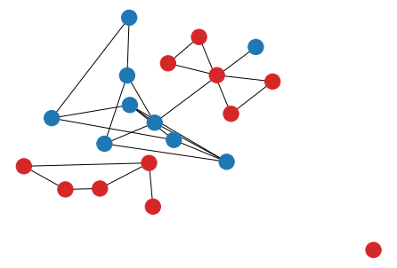
Progress
Network without the cut
N = 20
Network with Max-cut
N = 20
variational: [-50, -46]
exact: min(E) = -51
Shots: 30
Updates: 15
Certainly wrong

Slide 30
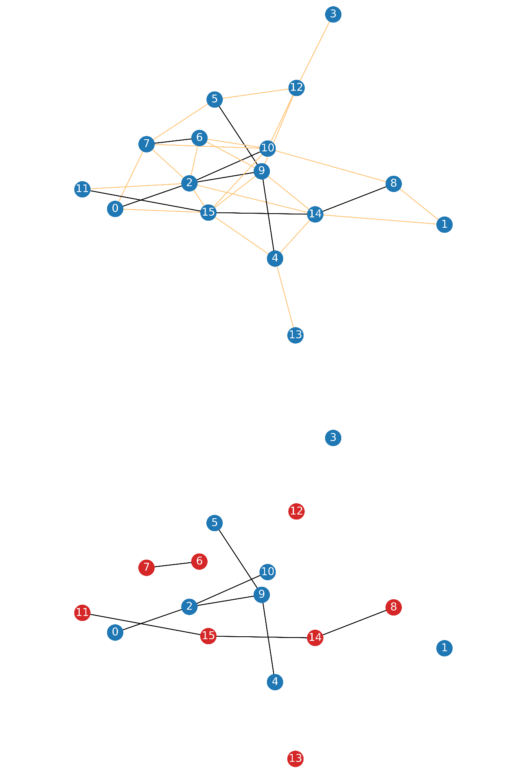
Progress
Network without the cut
N = 16
Network with Max-cut
N = 16
Variational (best): - 24
exact: min(E) = -24
Shots: 20
Updates: 30

Slide 31
Overview
Combinatorial optimization: QUBO
Boson sampling: How to convert discrete to continous?
Variational solver: boson sampler – part of an optimizer
Progress results

Slide 32
Combinatorial optimization
Combinatorial optimisation problems:
Discrete variables (instead of continous)
Optimizing over discrete >> continous variables
Constraints?
Continous: add to the objective function! (eg. Lagrangian multiplier)
Discrete is hard, if there are constraints (check every case)
It is even harder for binary (0,1) variables: brute force method

Slide 33

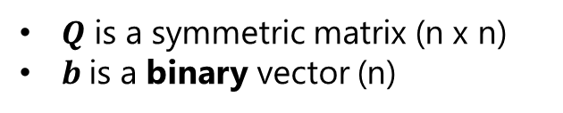
Quadratic unconstrained binary optimization - QUBO
$$〈 b | Q| b 〉$$
$Q$ is a symmetric matrix (n x n)
$b$is a binary vector (n)
$〈 10010 | Q| 10010 〉$ = scalar
Applications:
Finance
Logistics
Number theory
Scheduling
Graph theory
Optimization problem:
We want to find $b$ such that
$$\min\left(〈 b |Q\right|b 〉)$$
Size of problem $n→2^{n}$ possible solutions
Binary optimization is expensive.
Notes:
This time we put less emphasis on using the boson sampler simulator and more on understanding the application that we’re dealing with.

Slide 34

Interferometer
Beam splitters and phase shifters (continous variables)
Gard et al. "An introduction to boson-sampling.„ 2016
Bradler, Wallner. "Certain properties and applications of shallow bosonic circuits.„ 2021
Notes:
What is a boson sampler and how it works?
Here is what the boson sampler does on a diagram.
On top, there are single photon states and vacuum states, that are propagated through a linear optics network.
It implements a unitary map on the single photon creation operators like this.
Then at the output we’ve got some big superpositions of the multiphoton optical states.
This linear optic network is basically an interferometer made of beam splitters and phase shifters as it can be seen on the diagram on the left.
In this notation S represents a configuration of where the photons could arrive.
Gamma represents the amplitude associated with that configuration.
N sub 1 super S is the number of photons in the state 1 in the configuration S.
The output state represent all the possible configurations.
Then we measure the output and we get the S configuration with absolute gamma squared probability.
So the goal is to build up statistics of what P of S looks like.

Slide 35
Boson sampling
Single photon quantum states
Interferometer
Multiphoton quantum state
Gard et al. "An introduction to boson-sampling.„ 2016
Notes:
What is a boson sampler and how it works?
Here is what the boson sampler does on a diagram.
On top, there are single photon states in n modes and vacuum states in the remaining of the m modes.
Note: there is only one photon per mode.
This input state is propagated through a linear optics network.
It implements a unitary map on the creation operators like this.
The unitary map depends
Then at the output we’ve got some big superpositions of the multiphoton optical states.
In this notation S represents a configuration of where the photons could arrive.
Gamma represents the amplitude associated with that configuration.
N sub 1 super S is the number of photons in the state 1 in the configuration S.
The output state represent all the possible configurations.
Then we measure the output and we get the S configuration with absolute gamma squared probability.
So the goal is to build up statistics of what P of S looks like.

Slide 36
Boson sampling: interferometer
Interferometer
Single photon quantum states
Interferometer
Multiphoton quantum state
Beam splitters and phase shifters
Gard et al. "An introduction to boson-sampling.„ 2016
Bradler, Wallner. "Certain properties and applications of shallow bosonic circuits.„ 2021
Notes:
What is a boson sampler and how it works?
Here is what the boson sampler does on a diagram.
On top, there are single photon states in n modes and vacuum states in the remaining of the m modes.
Note: there is only one photon per mode.
This input state is propagated through a linear optics network.
It implements a unitary map on the creation operators like this.
The unitary map depends
Then at the output we’ve got some big superpositions of the multiphoton optical states.
In this notation S represents a configuration of where the photons could arrive.
Gamma represents the amplitude associated with that configuration.
N sub 1 super S is the number of photons in the state 1 in the configuration S.
The output state represent all the possible configurations.
Then we measure the output and we get the S configuration with absolute gamma squared probability.
So the goal is to build up statistics of what P of S looks like.

Slide 37
Boson sampling: interferometer
Interferometer
Single photon quantum states
Interferometer
Multiphoton quantum state
Beam splitters and phase shifters
discrete
continous
Gard et al. "An introduction to boson-sampling.„ 2016
Bradler, Wallner. "Certain properties and applications of shallow bosonic circuits.„ 2021
Notes:
What is a boson sampler and how it works?
Here is what the boson sampler does on a diagram.
On top, there are single photon states in n modes and vacuum states in the remaining of the m modes.
Note: there is only one photon per mode.
This input state is propagated through a linear optics network.
It implements a unitary map on the creation operators like this.
The unitary map depends
Then at the output we’ve got some big superpositions of the multiphoton optical states.
In this notation S represents a configuration of where the photons could arrive.
Gamma represents the amplitude associated with that configuration.
N sub 1 super S is the number of photons in the state 1 in the configuration S.
The output state represent all the possible configurations.
Then we measure the output and we get the S configuration with absolute gamma squared probability.
So the goal is to build up statistics of what P of S looks like.

Slide 38
Boson sampling: distribution and energy
Repeat measurement many times
Distribution of quantum states:
Single photon quantum states
Interferometer
Multiphoton quantum state
Notes:
What is a boson sampler and how it works?
Here is what the boson sampler does on a diagram.
On top, there are single photon states in n modes and vacuum states in the remaining of the m modes.
Note: there is only one photon per mode.
This input state is propagated through a linear optics network.
It implements a unitary map on the creation operators like this.
The unitary map depends
Then at the output we’ve got some big superpositions of the multiphoton optical states.
In this notation S represents a configuration of where the photons could arrive.
Gamma represents the amplitude associated with that configuration.
N sub 1 super S is the number of photons in the state 1 in the configuration S.
The output state represent all the possible configurations.
Then we measure the output and we get the S configuration with absolute gamma squared probability.
So the goal is to build up statistics of what P of S looks like.

Slide 39

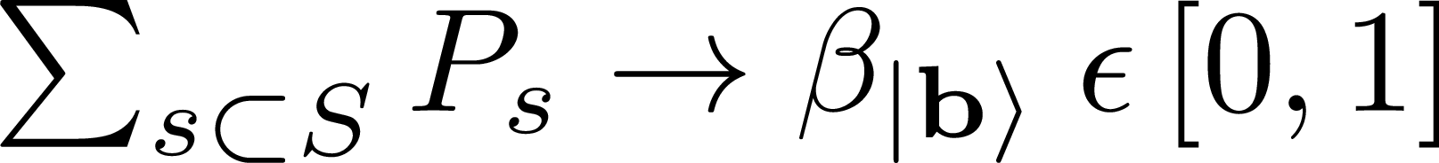
Boson sampling: distribution and energy
Repeat measurement many times
Distribution of quantum states:
...
Mapping to qubit basis:
binary vectors
Single photon quantum states
Interferometer
Depends on
Fixed
Multiphoton quantum state
Goal: find
Notes:
What is a boson sampler and how it works?
Here is what the boson sampler does on a diagram.
On top, there are single photon states in n modes and vacuum states in the remaining of the m modes.
Note: there is only one photon per mode.
This input state is propagated through a linear optics network.
It implements a unitary map on the creation operators like this.
The unitary map depends
Then at the output we’ve got some big superpositions of the multiphoton optical states.
In this notation S represents a configuration of where the photons could arrive.
Gamma represents the amplitude associated with that configuration.
N sub 1 super S is the number of photons in the state 1 in the configuration S.
The output state represent all the possible configurations.
Then we measure the output and we get the S configuration with absolute gamma squared probability.
So the goal is to build up statistics of what P of S looks like.

Slide 40
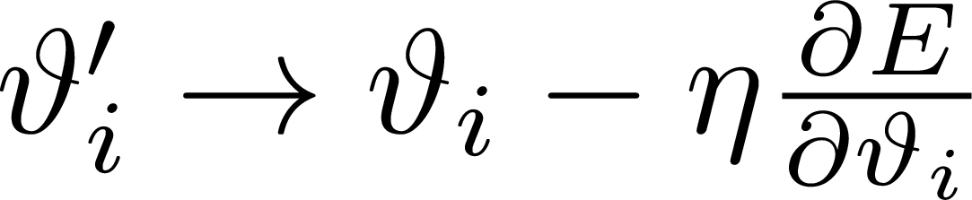
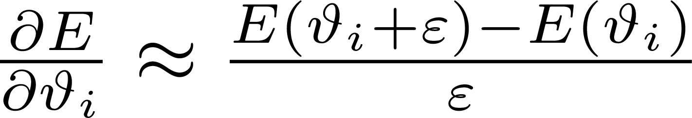

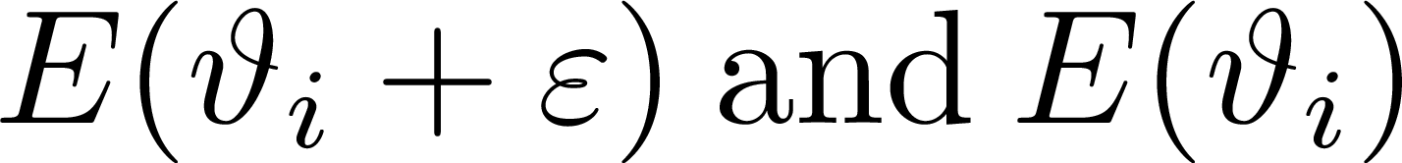
Variational solver: gradient descent
Apply gradient descent:
Need to compute the gradient
Approximating the gradient:
Practically infeasible
Very high accuracy in tuning optical components ( is small)
Need many samples to capture difference bw distributions ( )
Use the parameter shift rule instead:
Hint: trigonometric functions backing it up
Notes:
What is a boson sampler and how it works?
Here is what the boson sampler does on a diagram.
On top, there are single photon states in n modes and vacuum states in the remaining of the m modes.
Note: there is only one photon per mode.
This input state is propagated through a linear optics network.
It implements a unitary map on the creation operators like this.
The unitary map depends
Then at the output we’ve got some big superpositions of the multiphoton optical states.
In this notation S represents a configuration of where the photons could arrive.
Gamma represents the amplitude associated with that configuration.
N sub 1 super S is the number of photons in the state 1 in the configuration S.
The output state represent all the possible configurations.
Then we measure the output and we get the S configuration with absolute gamma squared probability.
So the goal is to build up statistics of what P of S looks like.

Slide 41
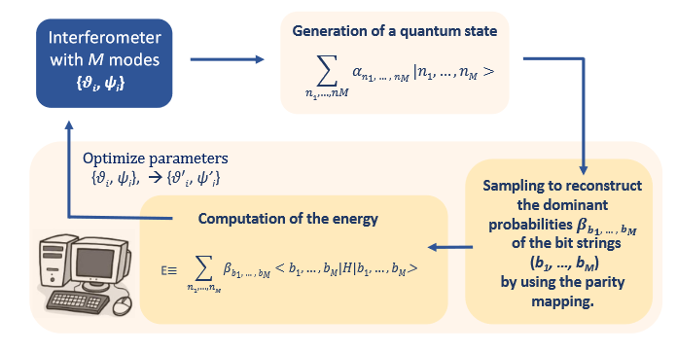
Model overview
Bradler, Wallner. "Certain properties and applications of shallow bosonic circuits.„ 2021
Notes:
How does the boson sampler come into play?
This is the model overview of the variational bosonic solver.
In the first step we generate a quantum state with the M-mode interferometer.
This interferometer has some parameters, that are tunable
The amplitudes of the quantum states depend on the circuit elements’ angles, thetas and psis.
Then we apply a parity function so that the we map the optical states to a many-qubit hilbert space. Then we have our qubits.
Note: Each qubit state has a some energy associated with it.
So we apply the parity functions and record the amplitudes of the qubits.
Then using these amplitudes and the qubit states we calculate the expected value of the energy – it is the objective function, that we try to minimize.
Then we tweak the psi and theta parameters with gradient descent and do the previous steps again.
The goal is to find the smallest energy and the associated bit string.
So, how can we use this ? We need to formulate our our problem as optimizing the energy by choosing an appropriate Hamiltonian matrix.

Slide 42
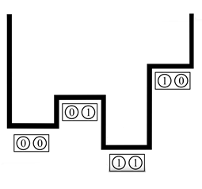

Boson sampling
Relation to matrix permanents:
A – unitary of the linear optics network
Complex-valued permanent: #P problem
Boson sampling is classically inefficient
Gard, Bryan T., et al. "An introduction to boson-sampling.„ 2016
Notes:
Then the question is why do we need a quantum computer for that?
One of the key results is that measuring the probability of a given configuration is proportional to a permanent of the A matrix.
The A matrix is a unitary transformation describing the linear optics network and the output configuration.
It is a very hard problem to calculate complex-valued matrix permanents. So boson sampling is classically inefficient to simulate, we need a real quantum device to that.

Slide 43
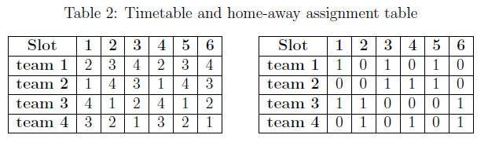
Application: break minimization
Break: when a team plays two consecutive games at home or away
Timetable shows which teams play when
Home-away assignment table shows where the game is played
Kuramata et al. "Solving Large Break Minimization Problems in a Mirrored Double Round-robin Tournament Using Quantum Annealing."

Slide 44
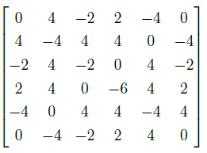
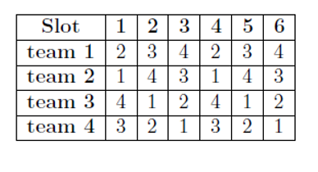
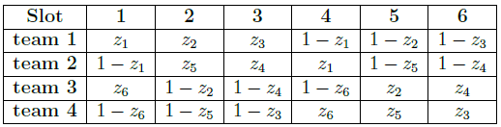
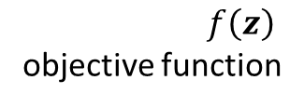
Break minimization: formulation
Take a timetable
Group the coefficients
Create an assignment schema
$f\left(z\right)$
objective function
Find z vector(s)
/w minimal <Q>

Slide 45
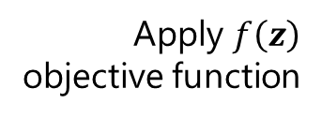
Break minimization: formulation
Take a timetable
Group the coefficients
Create an assignment schema
Find z vector(s)
/w minimal <Q>
Apply $f\left(z\right)$
objective function

Slide 46

QUBO and number of breaks
Calculated the <z|Q|z> for all z in a tournament (all possible home-away assignment table)
Implemented a break counting algorithm, given a timetable and a z vector
Compared energy and number of breaks
Expected a linear connection between breaks and energy (<Q> = <E>)
Found no clear correspondence bw breaks and expected value
Perhaps Q calculated wrongly
Notes:
Unfortunatly we found no clear correspondence between the expected value of the QUBO matrix and the number of breaks.
This leads to the conclusion that perhaps the Q matrix is calculated in a wrong way.
In the future we might try using different timetables with the same calculations, however we presume that it is not very likely to generate better results.

Slide 47
Progress
Calculated the <z|Q|z> for all z in a tournament
Counted breaks for every z
Compared energy and number of breaks
Expected a linear connection between breaks and energy (<Q> = <E>)
Found no clear correspondence bw breaks and expected value
Perhaps Q calculated wrongly

Slide 48



Progress
previous
Calculated the <z|Q|z> for all z in a tournament
Counted breaks for every z
Compared energy and number of breaks
Expected a linear connection between breaks and energy (<Q> = <E>)
Q was calculated wrongly (change up )
Overlapping data points – noise
Correspondence bw energies and breaks
The lowest energy configuration paired with a min-break $→$ quantum annealing is viable
recent

Slide 49
Conclusion
Break minimization: less of two home/away games in a row
Goal: generate home-away assigment tables (where teams play)
Formulating a QUBO problem based on break minimization

Slide 50




Side note: Barabási-Albert graph
Last report: How can there be a such a lonely node?
Parameters: n – final num of nodes
m – edges from new nodes
NetworkX reference - networkx — NetworkX documentation. (n.d.). Retrieved April 26, 2022, from https://networkx.org/documentation/stable/_downloads/networkx_reference.pdf
Notes:
During the last presentation I was asked if I could expleain: how can there be such a lonely node?
Of course I looked into that because I wasnt satisfied with the previous results on the max cut, so I wanted to know if the error lied behind the graph’s representation.
Although the problem was somewhere else, I wanted to dispel any doubt, so here it is what I found in the documentation.
We know about the Barabási-Albert graph generation that it is an iterative process and in the end it ends up with N final nodes.
So in the beginning there has to be an initial graph, to which we connect the edges of the new incoming nodes.
I looked it up on the documentation, that this initial graph is a star graph that looks like this.
So that lonely node can be one of the initial nodes.

